Slide 1
Metroid Isolation
Himnish Nanda

Slide 2
Themes
Sci-fi
Trust
Exploration
Action
Politics
Truth

Slide 3
Main protag
Name: Sarah
Age: 21
Current Occupation: Bounty Hunter
Likes: technology
Dislikes: ????
She was raised by the galactic federation and she’s like family to them till they recommend you on a mission.

Slide 4
Main antagonist
Name: Sylux
Age: ?????
Likes: ????
Dislikes: the Galactic Federation
Past History: ??????

Slide 5
Plot - Part 1
Starts off by showing the main base of the Galactic Federation and everyone is peaceful there.
The game then introduces to Samus Aran who was responsible for the fall of the Space Pirates months ago.
Suddenly, the Galactic Federation receives a distress signal near a planet called Talon IV which Samus immediately flies over there.
Months ago, the leaders had received a signal that came from an unknown location.
It took several months to decipher it and what came to had shook them to their core. In order to put this signal to rest they hired the main protag. Sarah who showed up out of nowhere.

Slide 6
Plot - part 2
She then gets set assignments on specific planets starting with Zebes.
On Zebes, after exploring and fighting a couple of bosses Sarah finds her way down to Tourian where she finds a control terminal. By using her programming expertise, she manages to hack the terminal and finds herself several footage.
A lot of the footage were about the experiments at Tallon IV but the last one was something that frightened Sarah to the core. The footage showed a purple suited hunter who had several ferocious conversations regarding the source and the hunter Samus Aran.

Slide 7
Plot - part 3
The purple hunter then faces to the camera saying, “Found you!”. Suddenly, she slips and sets off the alarm alerting the alarms.
She then gets caved in thanks to elite pirates and runs into an area known as Chozodia. After exploring the artifacts of Chozodia Sarah found a secret exit and escaped Planet Zebes.
Months flew by, within that time she heard rumours here and there about this mysterious hunter. Some were about how he stole Galactic weaponry to sell illegally to Space Pirates or how he was part of a prophet.

Slide 8
Plot - part 4
She then gets a call out of nowhere, sending Sarah to her next assignment on Planet Aether.
Her job was more to help Aether get rid of the corrupted phazon atmosphere, Sarah injected non -hostile parasites to feed of the corrupted phazon and its gasses. Whilst doing so she secretly scoops up some phazon and does some experiments which provided interesting results.
After doing these experiments, she finds herself a prototype just outside of her base. The prototype shows a suit which looked like a more advanced varia suit.

Slide 9
Plot - part 5
She then proceeds to send a digital version of the prototype to the Federation. The Federation then uses that data and added a few tweaks to produce the PED suit.
Within months, Sarah had managed to reduce the corrupted atmosphere of planet Aether.
Sarah then notices an unnatural meteor appears and a Luminoth warned Sarah that “A storm is coming.”.

Slide 10
Plot - part 7
After the investigation at Aether, she started to suspect the Galactic Federation since they were reluctant to be clear on their objective. However, there was one thing on her mind and that was that prototype dropped out of the blue. Who could have dropped it? Furthermore, how does this hunter connect to all this and what is the source?
She was then given a special request to explore through SR388. When reached there, she notices Samus and flies over to a different part of SR388.
There Sarah discovers an abandoned factory, upon further explorations she had discovered artworks of the Chozo at SR388 and their tragic end.

Slide 11
Plot - part 8
Sarah encounters a sealed door which only opens for those who share the blood of the Chozo. To her surprise, Sarah’s blood was 100% Chozo and she advanced perplexed to what happened.
She encounters several heavy Chozo military weaponry and at the far back she notices a drilling machine known as ‘Diggernaut’. This machine then suddenly goes rampant and then starts attacking Sarah furiously . The battle ends with Diggernaut becoming mal-functioned and chucks Sarah hard against the wall causing a back injury.
Sarah sees two shadows and then proceeds to follow them. She had finally found the mysterious purple hunter along with proteus Ridley.

Slide 12
Plot - Part 9
She is then smack talked which provokes her to charge at the hunter only to be swiftly put down by Ridley and then dragged herself against the wall. Ridley then roars as starts to chase down Samus Aran.
Sarah then gets beaten up nonchalantly by the hunter as she misses each attack and passes out.
As she struggles and topple over the stars, Sarah then notices hidden Chozo art which felt deeply nostalgic. As she entered, she noticed the “Chozo Suit” and quickly equipped it. Once she equipped it, she heard her father’s last message and quickly flies off to the Space Pirate Homeworld without letting anybody know.

Slide 13
Normal ending
As she lands and runs towards the Space Pirate Homeworld she found the hunter after jumping from a pillar.
However, it took only two punches to finish him off. Suddenly, the hunter set off a self-destruct causing the homework to blow sky high.
After the incident ensued the Galactic Federation tried to find clues on Sarah but found nothing. At the end of the day, both Sarah and the hunter disappeared.

Slide 14
Secret ending 1 - Perfect Ending
The Galactic Federation had managed to find Sarah after years of searching and she finally managed to meet her elder sister Samus Aran.

Slide 15
Secret ending - other ending
Sarah teams up with Sylux after a few conflicts and decides to take down the Galactic Federation.

Slide 16
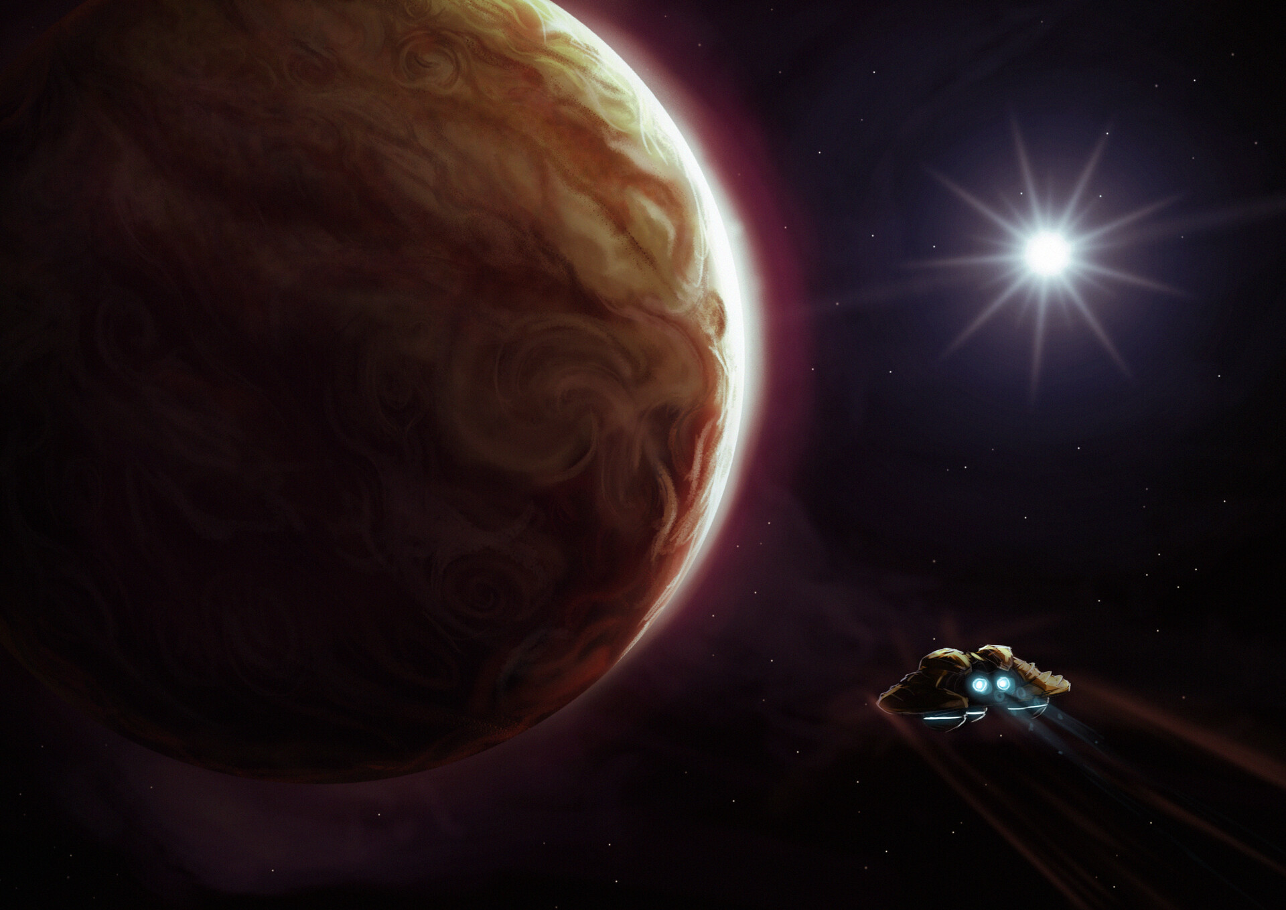
Planet Zebes
Originally, one of the heart home foundation of the Chozo.
Since the loss of the Chozo has been barren and wrought with dangerous terrain and vicious beasts.
It was forgotten till the Space Pirates infiltrated it and started wreaking havoc.
Samus Defeated the Space Pirate and peace returned or so everyone had thought…..

Slide 17
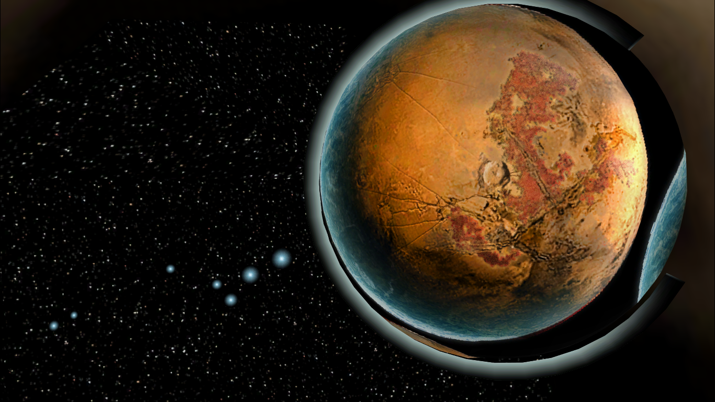
Planet Tallon iv
Tallon IV was the next main Homeworld for the Chozo until the Metroid Prime had hit it in the form of a meteor and spread its phazon all over the planet infecting everything.
A team of space pirates had received a sudden spike in energy and had decided to check it out. At the end only half of the team survived. It was there they decided to start their bioweapons engineering from there causing several failed experiments.
This planets have a variety of regions; a fiery Magmoor Cavern,
the icy reigns of Phendana Drifts, the mossy Chozo Ruins and the Phazon Mines.

Slide 18
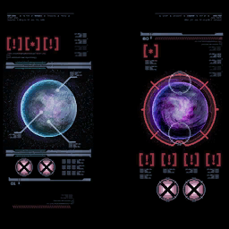
Planet Aether
This planet contains the cousins to the Chozo known as the Luminoth. The Luminoth are an advanced race that were able to store light as a source for power.
A leviathan seed had hit Planet Aether so badly to the point it split up the world into a light world and a dark world.
Filled with poisonous Phazon gas, it’s a race to save Aether from destruction.

Slide 19
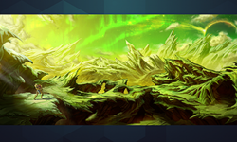
Planet SR388
The Homeworld of the Metroids, they were created to fight against threats specifically the X Parasites.
Metroids are known as the “Apex Predators” because it’s unstoppable and ability to be the quickest organism in the game to adapt.
Suddenly, they mutated and started killing everything in its sights leaving nothing alive.

Slide 20
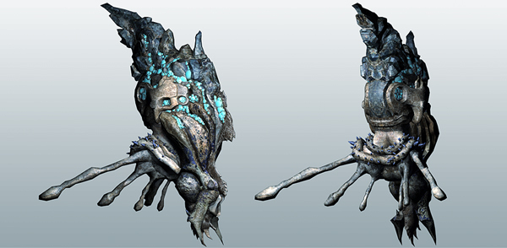
Leviathan seed
Leviathan Seeds are ammo for a machine known as the Phazon Cannon which was developed by the Space Pirates. They further enhance it to hit multiple planets all at once with higher accuracy.
These Leviathan Seeds contained enough amount of Phazon to cover a whole planet.

Slide 21
Referencing
Bearborg.(N/A).SR388.[online image].Accessed at: https://metroid.fandom.com/wiki/SR388
RoyboyX.(N/A).Aether.[online image].Accessed at: https://metroid.fandom.com/wiki/Aether
MMDModdler.(2016).Tallon IV Space.[online image].Accessed at: https://www.deviantart.com/mmdmoddler/art/Tallon-IV-Space-619330364
J.Sergio.(2019).Metroid Planet Zebes.[online image].Accessed at: https://www.artstation.com/artwork/lVvEBG
Hellkaiserryo12.(N/A).Leviathan.[online image].Accessed at: https://metroid.fandom.com/wiki/Leviathan?file=Leviathan_render.jpg

Slide 22
Thank you for listening!

